Slide 1
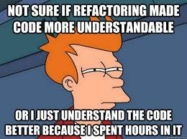
Refactoring patterns

Slide 2
Why talk about this?
Creates clear concepts in a muddy space
Gives us a common language to discuss how to change code architecture
They are patterns, just like programming patterns

Slide 3
What is refactoring?
Taking code from known state to known state
Changing the *structure* of the code without changing functionality
How do you know the state?
  Test Cases
  Good coverage

Slide 4
Challenges in Python
Python is a very dynamic language
MUST have test coverage to refactor well
Metaprogramming makes things easier if you've designed clear semantics
Metaprogramming makes things harder if you've focused on implementation

Slide 5
Refactoring Tools
https://github.com/python-rope/rope/blob/master/docs/rope.rst
bicyclerepair.sourceforge.net
https://www.jetbrains.com/pycharm/
sublimerope.readthedocs.org > En > Latest > Refactoring

Slide 6
The simple ones
Rename class
Rename variable
Rename module
Extract constant

Slide 7
More complex
Extract method
Inline method
change property -> method
change method -> property
change method signature

Slide 8
Inheritance/Classes
Insert class
Extract superclass
Inline Class

Slide 9
Inheritance/Methods & Properties
Pull up
Push down

Slide 10
A few antipatterns in code
Fat Object
"isinstance"

